Slide 1
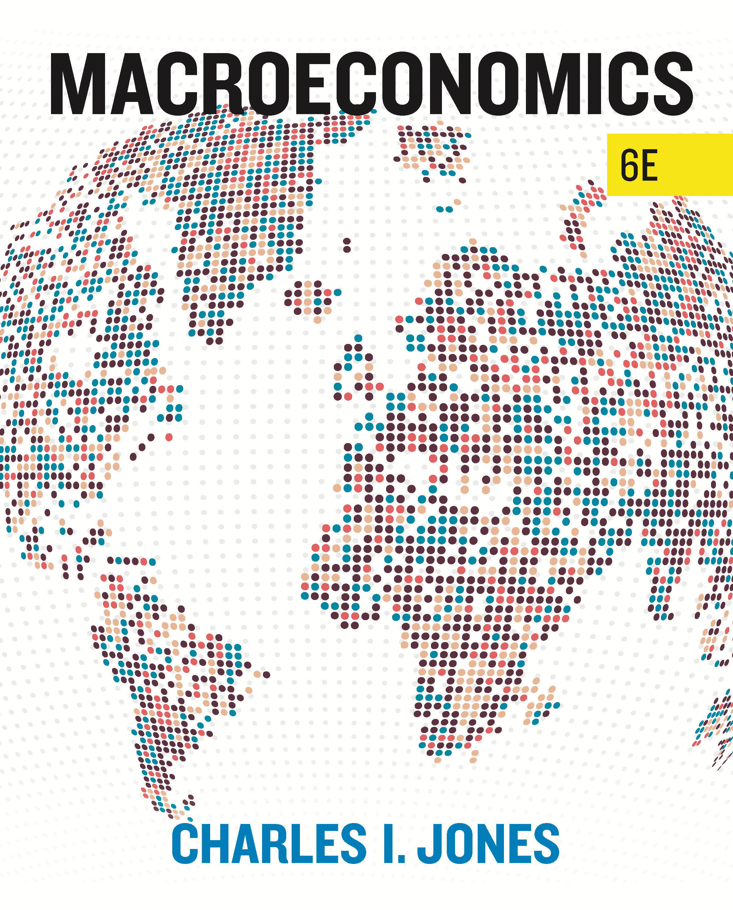
Chapter 8
Inflation
Macroeconomics, 6th edition
© 2024 by W. W. Norton & Company

Slide 2
8.1 Introduction
In this chapter, we learn
what inflation is, and how costly it can be.
how the quantity theory of money and the classical dichotomy help us understand inflation.
the relationship of interest rates and inflation through the Fisher equation.
the important link between fiscal policy and high inflation.

Slide 3
Inflation (1 of 2)
Inflation
Percentage change in the overall price level
Hyperinflation
Episode of extremely high inflation
Greater than 500 percent per year
Notes:
Inflation:
The percentage change in an economy’s overall price level
Hyperinflation:
Episodes of extremely high inflation
Greater than 500 percent per year
Has occurred throughout history
Examples of hyperinflation:
In the 1980s and 1990s, numerous episodes among the economies of Latin America
The inflation rate in Russia in the early 1990s transitioning to a noncommunist country reached more than 800 percent per year.
Zimbabwe in November 2008: prices doubled roughly every 24 hours and the inflation rate peaked at nearly 80 billion percent per month.
From 1919 to 1923, prices in Germany rose by over a factor of a trillion and were rising 300-fold each month.
We think the United States is immune to such episodes.
High inflation has often characterized the U.S. economy during major wars.
Image: The pengő (Hungarian currency) experienced the most severe rate of inflation ever recorded.
After losing value after World War II, the forint was introduced in August 1946.

Slide 4
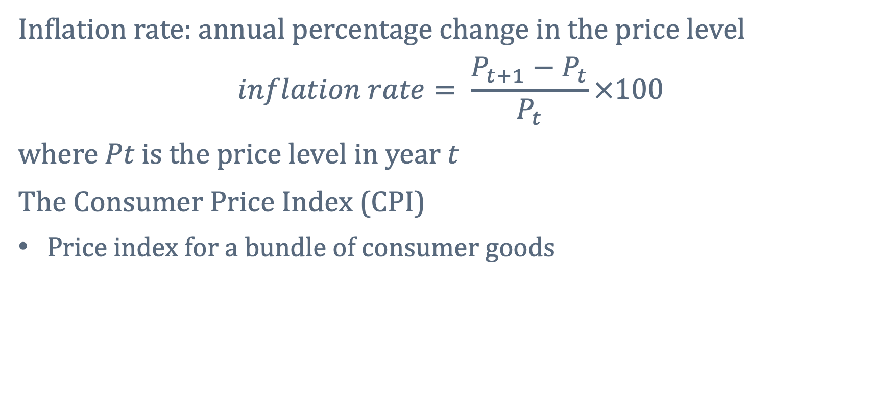
Inflation (2 of 2)
Inflation rate: annual percentage change in the price level
$$inflation rate= \frac{{P_{t+1}−P}_{t}}{P_{t}}×100$$
where 𝑃𝑡 is the price level in year t
The Consumer Price Index (CPI)
Price index for a bundle of consumer goods
Notes:
The CPI is one type of price level index that can be used to calculate inflation.
The CPI does a good job of identifying changes in cost of living.
It represents the cost of a basket of goods and services purchased by the average urban family of four.
The GDP deflator is another common price level index.
This is a broader measure of the price level, as it includes all goods and services in the economy.

Slide 5
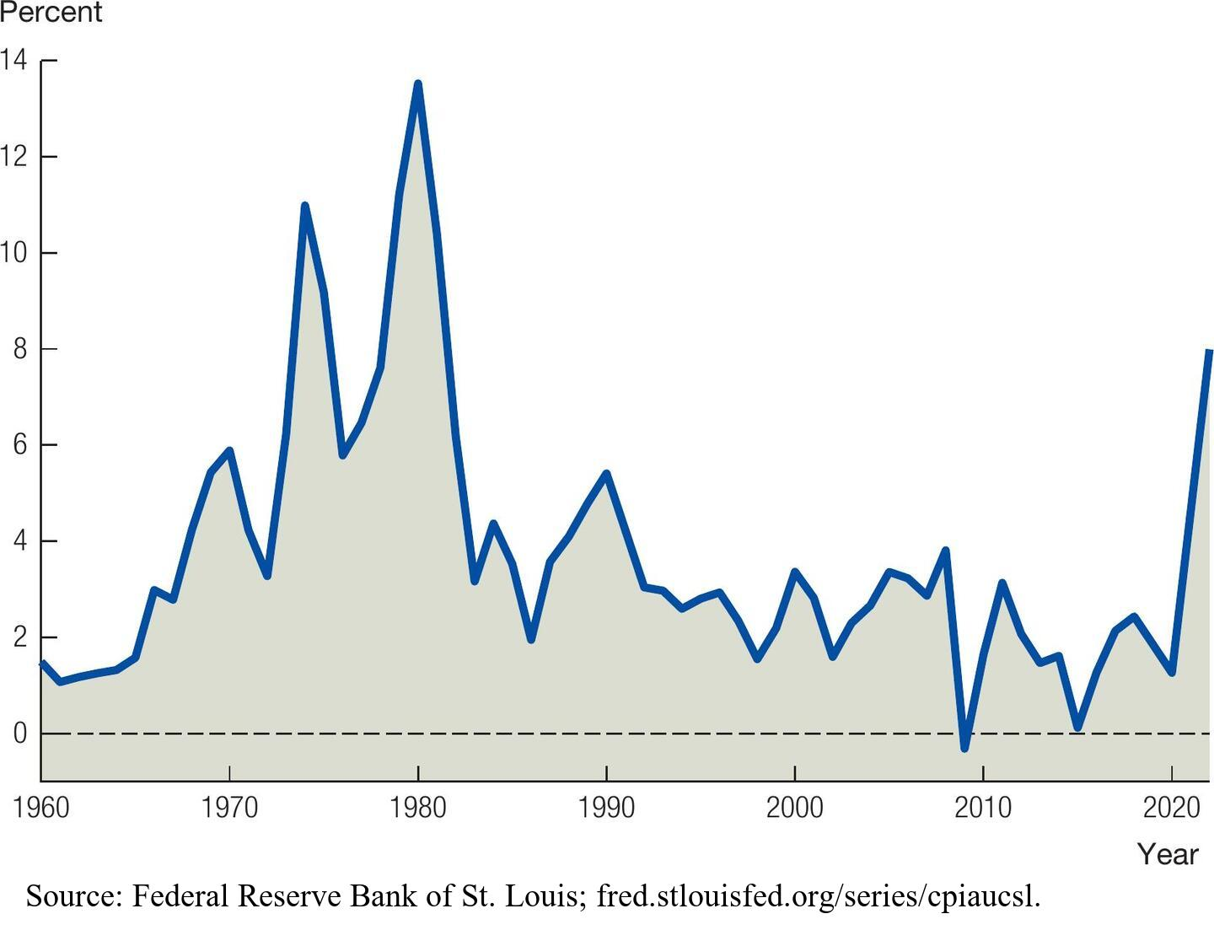
Inflation Rate in the United States
Notes:
Image: Figure 8.1, The Inflation Rate in the United States
Figure 8.1 shows the inflation rate in the United States for the last 45 years.
Since 1960, in the United States, inflation was at about 2 percent, until the Great Inflation of the 1970s.
After this period, inflation settled at about 2.5 percent.
Inflation was highest in 1980 at 13.5 percent.
This high inflation created arbitrary transfers of wealth and distorted incentives for investment.
Businesses that borrowed to finance investment faced extremely high interest rates, which led to a surge in bankruptcies.
In late 1979, Paul Volker became the chairman of the Fed and made fundamental changes to monetary policy.
The double-digit inflation was a huge part of the Reagan victory over Carter.
After this period, inflation rates fell and have remained around 2 percent for the last decade.
The Covid-19 pandemic brought about a return to high inflation throughout the United States and Europe, with the rate reaching 8 percent per year in 2022.
Source: Federal Reserve Economic Data (FRED), courtesy of the Federal Reserve Bank of St. Louis.

Slide 6
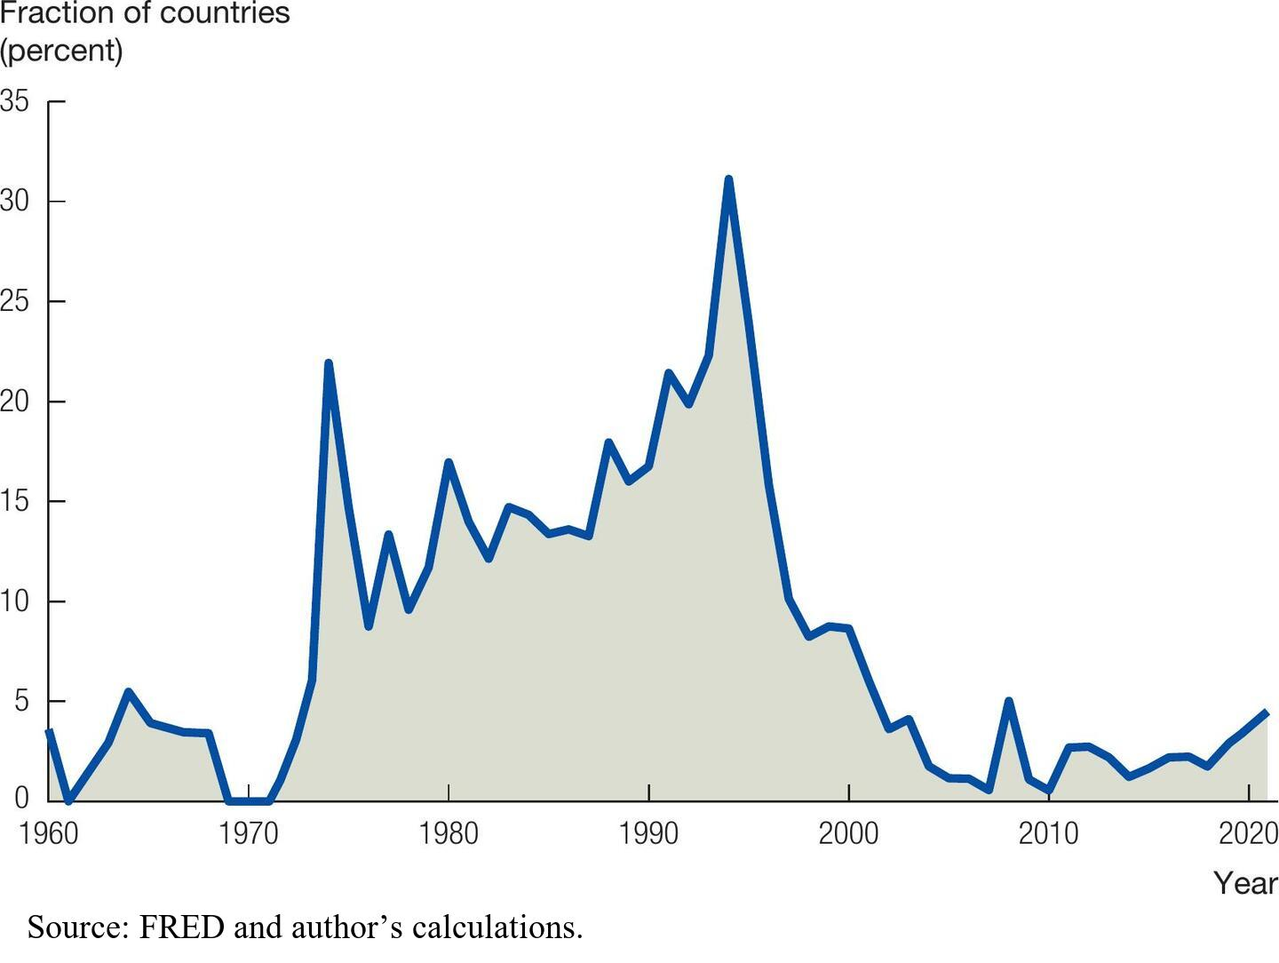
The Percentage of Countries Experiencing High Inflation
Notes:
Image: Figure 8.2, The Percentage of Countries Experiencing High Inflation
Figure 8.2 provides an international perspective on inflation and how it has changed over time by showing the fraction of countries in the world experiencing inflation rates greater than 25 percent in any given year.
In the 1960s less than 5 percent of countries experienced high inflation.
The number of countries experiencing high inflation increased significantly between 1970 and the mid-1990s.
By 1994, one out of every three countries in the world experienced inflation greater than 25 percent per year.
Since the mid 1990s this number has fallen sharply.
Since 2000, less than 5 percent of countries in the world are experiencing high inflation in any given year.
Source: Federal Reserve Economic Data (FRED), courtesy of the Federal Reserve Bank of St. Louis, and author’s calculations.

Slide 7
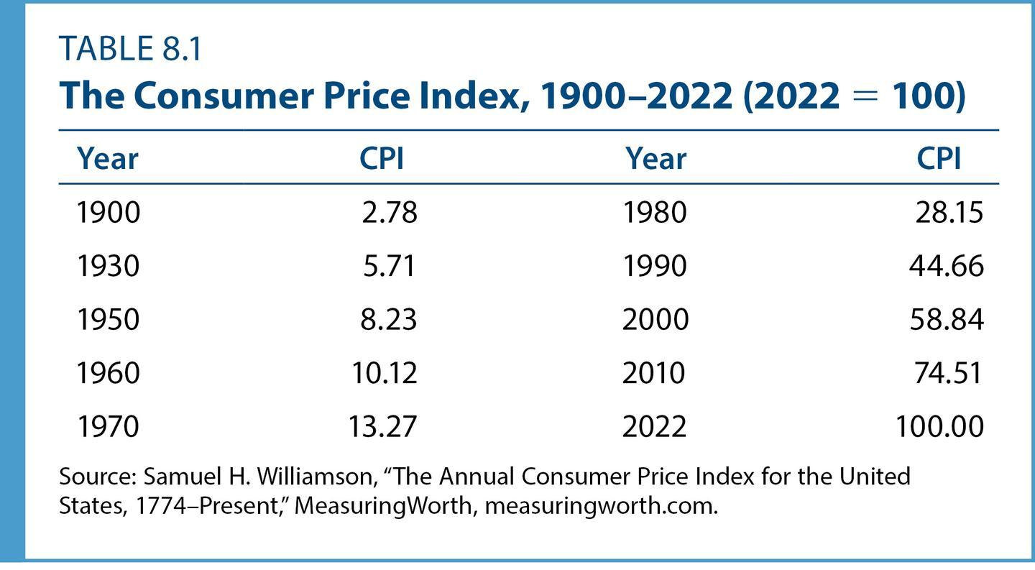
Case Study: How Much Is That? (1 of 2)
We can use the CPI to evaluate the value of a good in 1950 in today’s dollars.
Notes:
Table: Table 8.1, The Consumer Price Index, 1900-2022 (2022 = 100)
In 1950, a gallon of gasoline cost 27 cents, while in 2018 it cost around $3.50 in the United States.
How do we compare these numbers?
Was 27 cents in 1950 worth more or less than $3.50 in 2022?
This CPI comparison answers the question:
How many dollars in a given year have the same purchasing power as $100 in the year 2022?
Source: Lawrence H. Officer and Samuel H. Williamson, “The Annual Consumer Price Index for the United States, 1774–Present,” Measuring Worth, www.measuringworth.com.

Slide 8
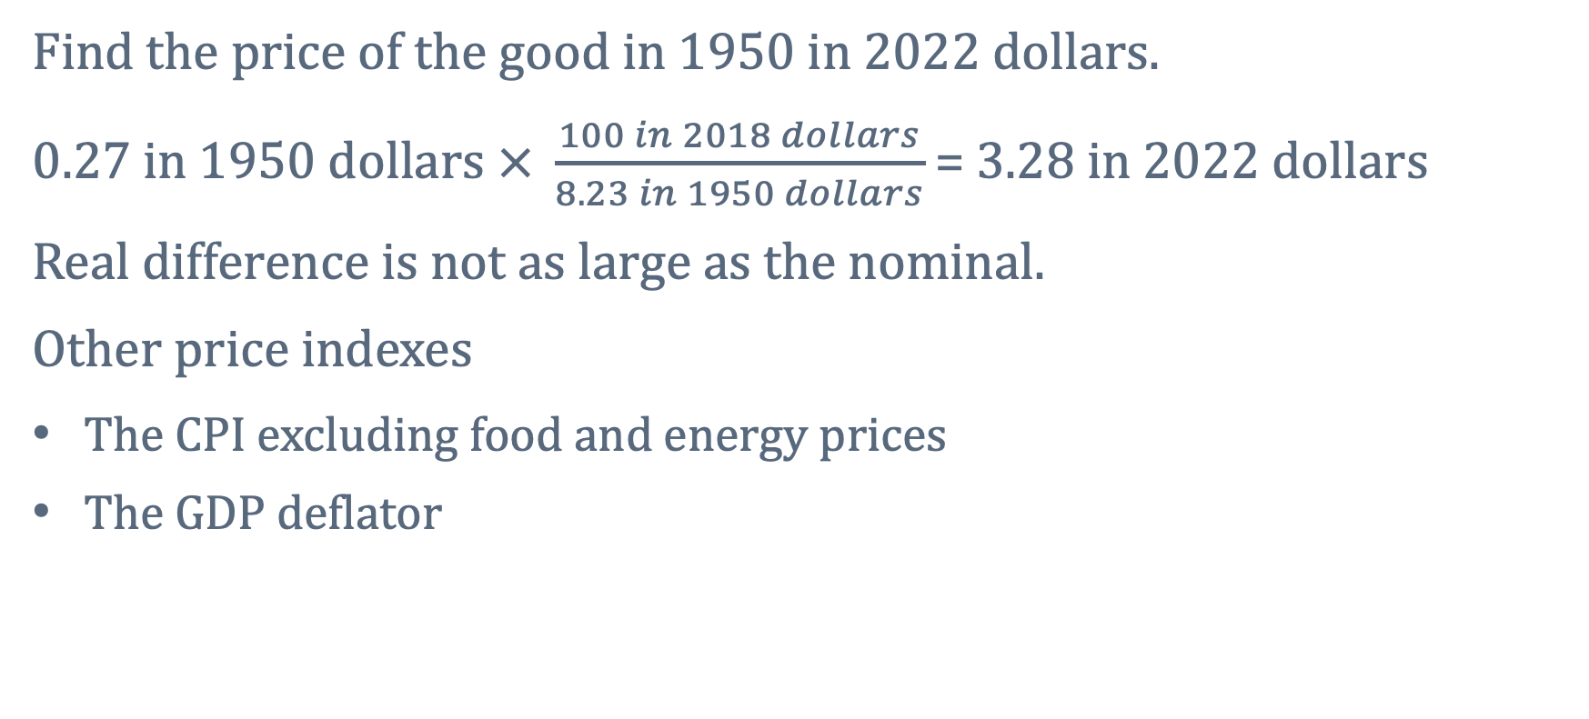
Case Study: How Much Is That? (2 of 2)
Find the price of the good in 1950 in 2022 dollars.
$0.27 in 1950 dollars$ $× \frac{100 in 2018 dollars}{8.23 in 1950 dollars}$ = 3.28 in 2022 dollars
Real difference is not as large as the nominal.
Other price indexes
The CPI excluding food and energy prices
The GDP deflator
Notes:
To obtain the equivalent 2018 value of 27 cents in 1950, we do the following “units” calculation:
Multiply the price of the good in 1950 times the ratio of the CPI in today’s dollars to the CPI in 1950 dollars.
We begin with 27 cents in 1950 dollars.
Then, we incorporate the fact that $100 in 2022 is equivalent to $8.23 in 1950.
The 1950 units cancel, and the value is $3.28 in 2022 dollars.
It’s not as large of a difference as the raw numbers may lead you to believe.
Gasoline was only a little cheaper in 1950 than in 2022, contrary to how low the 27 cents a gallon sounds, in part, because inflation has eroded the value of the dollar.
These different inflation measures are based on different baskets of goods, and therefore have different uses.
Workers bargaining with employers over wage increases may focus on the consumer price index.
Policymakers concerned about inflation may wish to exclude the volatile food and energy components.
By and large, however, these price indexes all give the same picture of inflation over moderately long periods.

Slide 9
8.2 The Quantity Theory of Money
We often think of money as paper currency.
Historically:
Money was backed by gold.
Today:
Currency is “fiat money.”
Paper that the government declares worth a certain price
Money has value because of social convention.
Notes:
There is a close connection between money and inflation.
First, we need to understand what money is. Examples include:
Seashells, rocks, and precious metals
Paper currency
Cigarettes in prisons
At the beginning of 2023, the amount of U.S. currency in circulation was $2.3 trillion, or more than $7,000 per person.
Paper currency has value because of government decree.
It is no longer backed by gold or silver.
There is a mutual agreement that paper currency will be accepted as payment.
Money has value because we expect others will value it and accept it as payment.

Slide 10
Measures of the Money Supply (1 of 2)
The monetary base includes currency and accounts (reserves).
Banks hold accounts with the economy’s central bank.
Under the Ample Reserves Framework, seen in the US and most major economies, the banking system holds ample reserves and earns interest on reserve balances.
Notes:
The monetary base includes currency and accounts that private banks hold with an economy’s central bank. These accounts are called reserves, and private banks can exchange these reserves for currency at will.
Since most major economies now operate under an Ample Reserves Framework where the banking system hold ample reserves, there is no longer a reserve requirement (0%).
Reserves are now paid interest on reserve balances by the federal reserve.

Slide 11
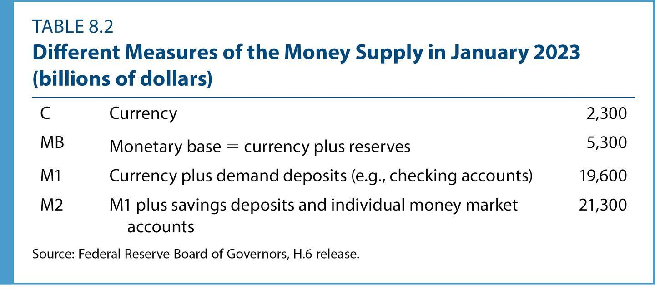
Measures of the Money Supply (2 of 2)
Notes:
Table: Table 8.2, Different Measures of the Money Supply in January 2023 (billions of dollars)
How do we measure the amount of money in an economy?
The answer depends on how narrowly we want to count.
Currency in circulation is a narrow measure, which equaled $2,300 billion in the United States in 2023, as shown in Table 8.2.
M1: adds demand deposits to the money base.
M2: adds savings accounts and money market account balances to M1.
As we add additional elements to the broader measures of the money, the accounts become less liquid.
An asset is less liquid if it is harder to turn into currency in a short period.
Source: Federal Reserve Board of Governors, H.6 and H.4.1.

Slide 12
Case Study: Digital Cash
Electronic forms of currency
Debit cards, PayPal, travelers’ checks, Venmo, Bitcoin
Makes up most money in advanced economies
Notes:
Innovations in the financial system change the way people think about money.
Frequent flyer miles, for example, are a new form of currency that can be used to purchase airline tickets, rental cars, and hotel rooms.
PayPal is an electronic currency that allows us to make purchases on the Internet.
The 30 million Octopus cards in use in Hong Kong (4X the population) allow people to buy a ticket on the Star Ferry, a chai latte at Starbucks, or lunch at McDonald’s simply by waving their wallets past a magnetic reader.
However, these innovations do not change the way economists think about money.
Purchases using PayPal and Venmo are deducted directly from a bank account.
The aggregate amount of money in circulation has not changed.
Most money in advanced economies today is already digital cash.
The balance in your savings account is just a number on a computer.
When you use the electronic “bill pay” feature of your bank to pay off a credit card bill, electrons zoom across networks to record the transaction.

Slide 13
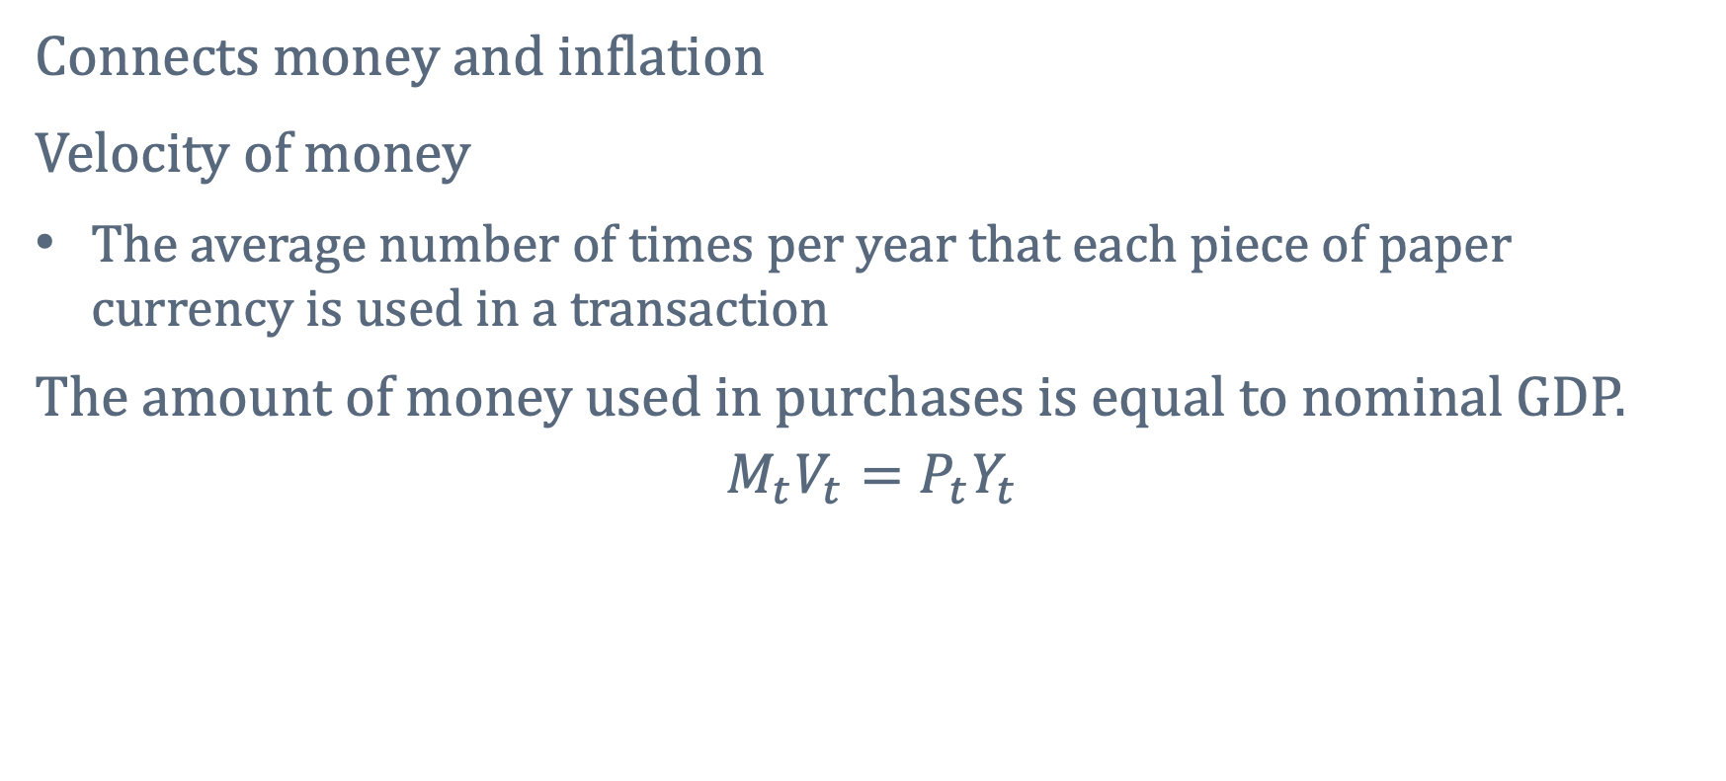
The Quantity Equation
Connects money and inflation
Velocity of money
The average number of times per year that each piece of paper currency is used in a transaction
The amount of money used in purchases is equal to nominal GDP.
$$M_{t}V_{t}=P_{t}Y_{t}$$
Money supply
Velocity of money
Price level
Real GDP
Notes:
Suppose M is currency.
The right-hand side of this equation is nominal GDP, total goods and services in the economy in current prices.
Goods and services are bought with money.
The left-hand side is money in circulation multiplied by the number of times each piece of paper changes hands, V .
The theory, then, says that nominal GDP is equal to the effective amount of money used in purchases, MV.

Slide 14
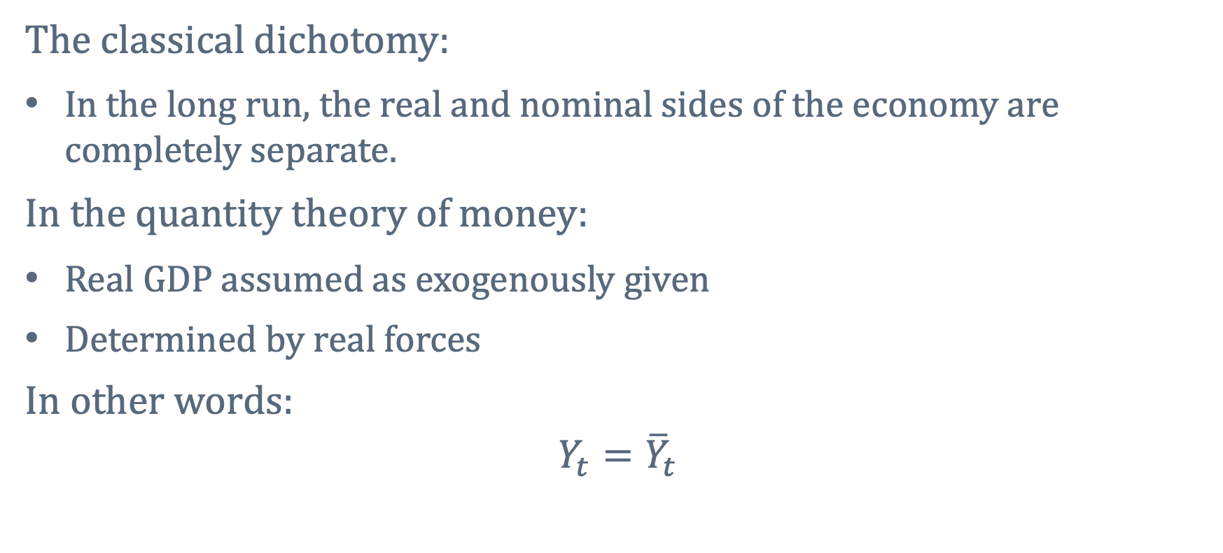
The Classical Dichotomy and Constant Velocity (1 of 2)
The classical dichotomy:
In the long run, the real and nominal sides of the economy are completely separate.
In the quantity theory of money:
Real GDP assumed as exogenously given
Determined by real forces
In other words:
$$Y_{t}={\overline{Y}}_{t}$$
Notes:
The classical dichotomy says that in the long run, the real and nominal sides of the economy are completely separate.
In particular, real GDP in the long run is determined solely by real considerations.
Indeed, the theory of long-run growth we developed earlier does not depend on money or the aggregate price level.
Instead, it depends on real variables like the investment rate, new ideas, and total factor productivity.

Slide 15
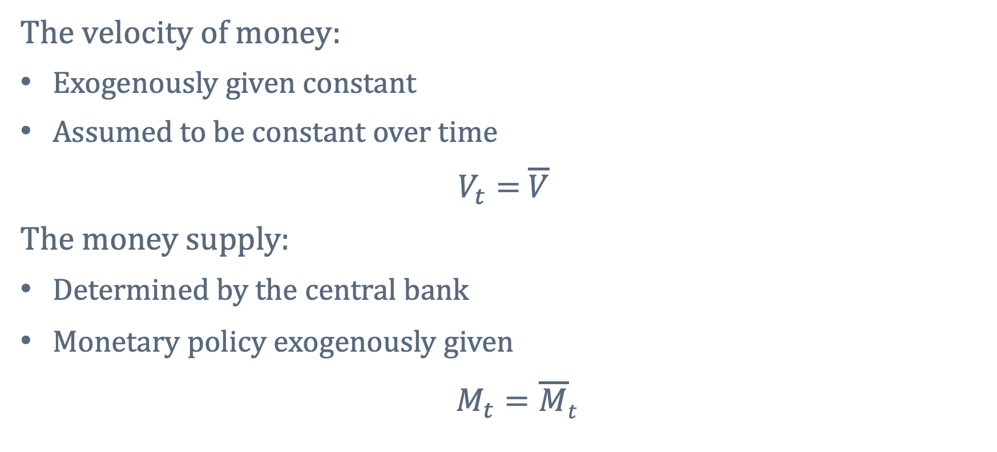
The Classical Dichotomy and Constant Velocity (2 of 2)
The velocity of money:
Exogenously given constant
Assumed to be constant over time
$V_{t}=$ $\overline{V}$
The money supply:
Determined by the central bank
Monetary policy exogenously given
$M_{t}=\overline{M}$_{t}
Notes:
Since the velocity of money is assumed to be constant over time, there are not time subscripts.
In reality, the velocity of the M2 definition of money is approximately constant.
So, in the long run, this is not an unreasonable assumption.
Monetary policy is assumed to be given exogenously.

Slide 16
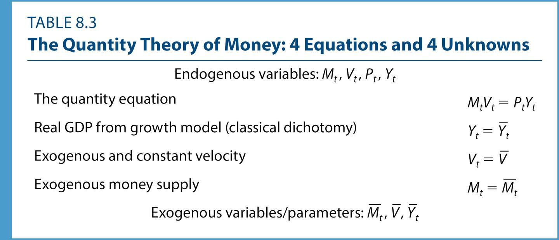
The Quantity Theory of Money
Notes:
Table: Table 8.3, The Quantity Theory of Money: 4 Equations and 4 Unknowns

Slide 17
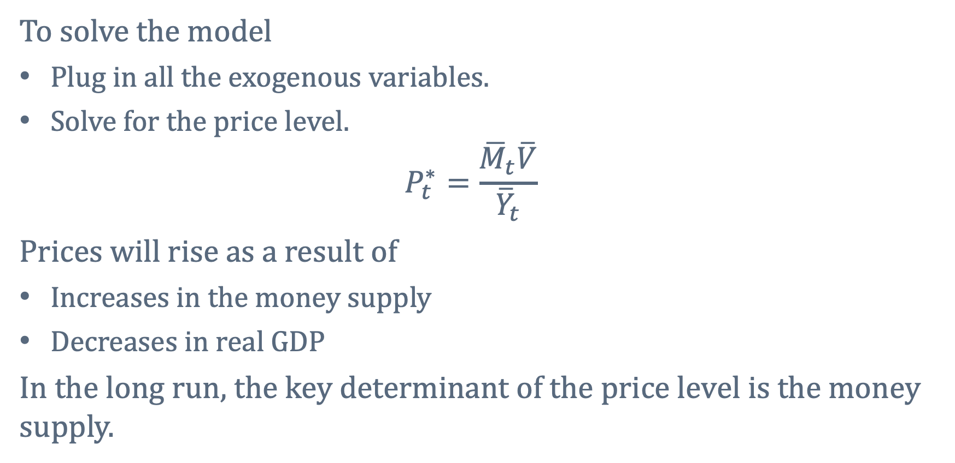
The Quantity Theory for the Price Level
To solve the model
Plug in all the exogenous variables.
Solve for the price level.
$$P_{t}^{∗}=\frac{{\overline{M}}_{t}\overline{V}}{{\overline{Y}}_{t}}$$
Prices will rise as a result of
Increases in the money supply
Decreases in real GDP
In the long run, the key determinant of the price level is the money supply.
Notes:
Essentially, the model consists of the quantity equation itself.
We assume real GDP, velocity, and money are determined exogenously.
So, the quantity equation is left to pin down the price level.

Slide 18
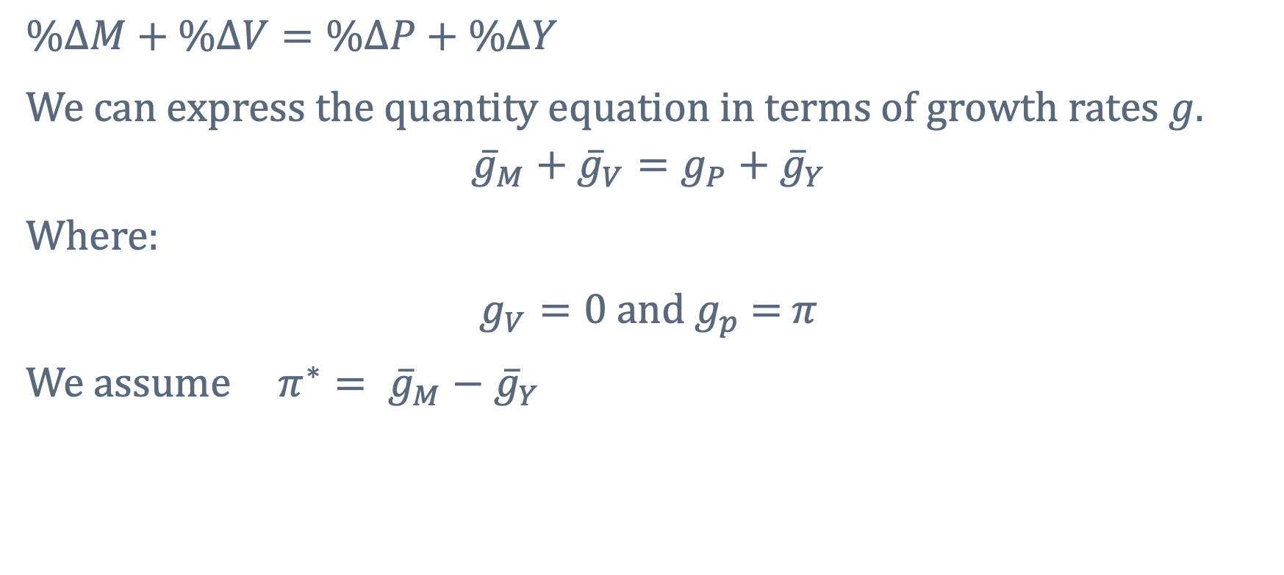
The Quantity Theory for Inflation (1 of 2)
$$\%∆M+\%∆V=\%∆P+\%∆Y$$
We can express the quantity equation in terms of growth rates $g$.
$${\overline{g}}_{M}+{\overline{g}}_{V}=g_{P}+{\overline{g}}_{Y}$$
Where:
$g_{V}=0 and g_{p}$ $=$ $π$
We assume $π^{∗}= {\overline{g}}_{M}−{\overline{g}}_{Y}$
Notes:
Recall, the inflation rate is the percentage change in the overall (aggregate) price level.
We can translate the quantity theory into a statement about inflation by applying the rules of growth rates.
The growth rate of the product of two variables is the sum of the growth rates of those variables.
Teaching Tip:
Again, for students who have taken calculus, we are taking the log of both sides of the quantity equation and totally differentiating with respect to time.

Slide 19
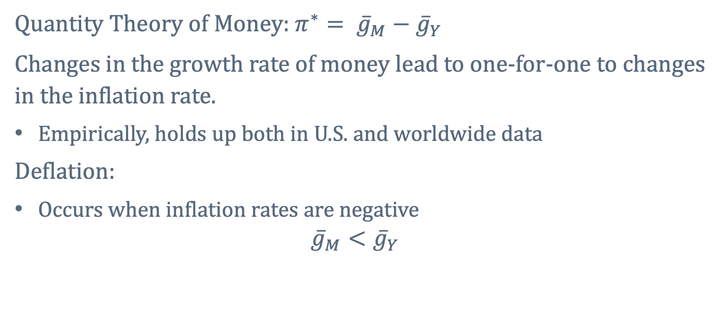
The Quantity Theory for Inflation (2 of 2)
Quantity Theory of Money: $π^{∗}= {\overline{g}}_{M}−{\overline{g}}_{Y}$
Changes in the growth rate of money lead to one-for-one to changes in the inflation rate.
Empirically, holds up both in U.S. and worldwide data
Deflation:
Occurs when inflation rates are negative
$${\overline{g}}_{M}<{\overline{g}}_{Y}$$
Notes:
Recall that changes in money growth do not change real GDP because of the classical dichotomy.
The growth rate of real GDP is determined in the long-run growth model.
The central bank controls the growth rate of money.
Consider an example:
Suppose 𝑔 bar sub 𝑀 = 7% and 𝑔 bar sub 𝑌 = 4%.
𝜋^∗ = 3%
Now suppose the central bank decides to increase the 𝑔 bar sub 𝑀 𝑡𝑜 10%.
In the long run, this extra money growth will leave the real economy unaffected (because of the classical dichotomy).
The only change will be that inflation will be higher, 𝜋^∗ = 6%.
It’s determined, in other words, by the rate of growth of the money supply.

Slide 20
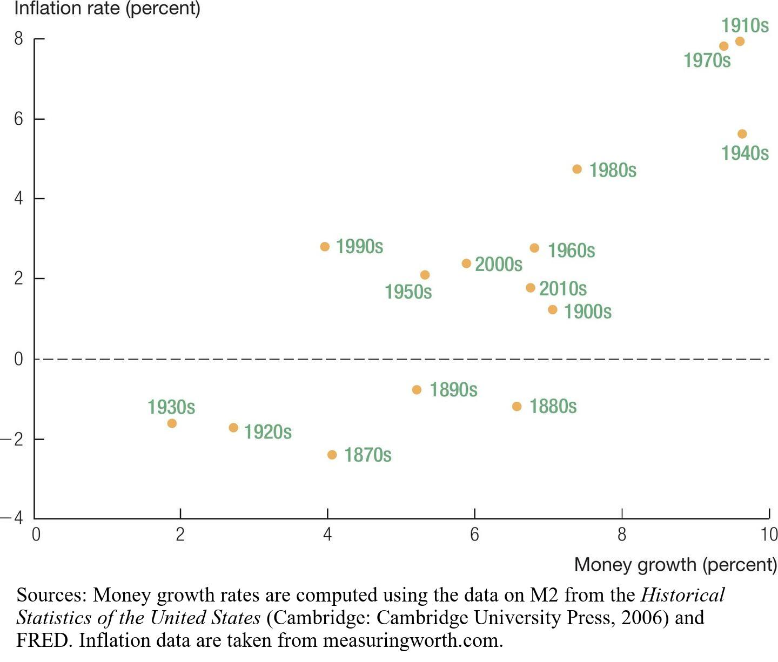
Money Growth and Inflation in the United States, 1870–2012
Notes:
Image: Figure 8.3, Money Growth and Inflation in the United States, 1870-2012
Figure 8.2 shows money growth rates and inflation rates by decade for the U.S. economy since the 1870s.
The main prediction of the quantity theory holds up in U.S. data: decades of high money growth are decades of high inflation.
It is evident that there is a strong relationship between money growth and inflation.
Decades of rapid money growth (1970s and 1910s) also show the highest rates of inflation.
Decades when money growth was slow (1920s and 1930s) have the lowest rates of inflation.
In fact, inflation rates were negative during these decades (deflation).
Sources: Money growth rates are computed using the data on M2 from the Historical Statistics of the United States (Cambridge: Cambridge University Press, 2006) and the Economic Report of the President, 2012. Inflation data are taken from John J. McCusker, “What Was the Inflation Rate Then?” Economic History Services, http://eh.net/hmit/inflation/. The “2000s” corresponds to the years 2000–2012.

Slide 21
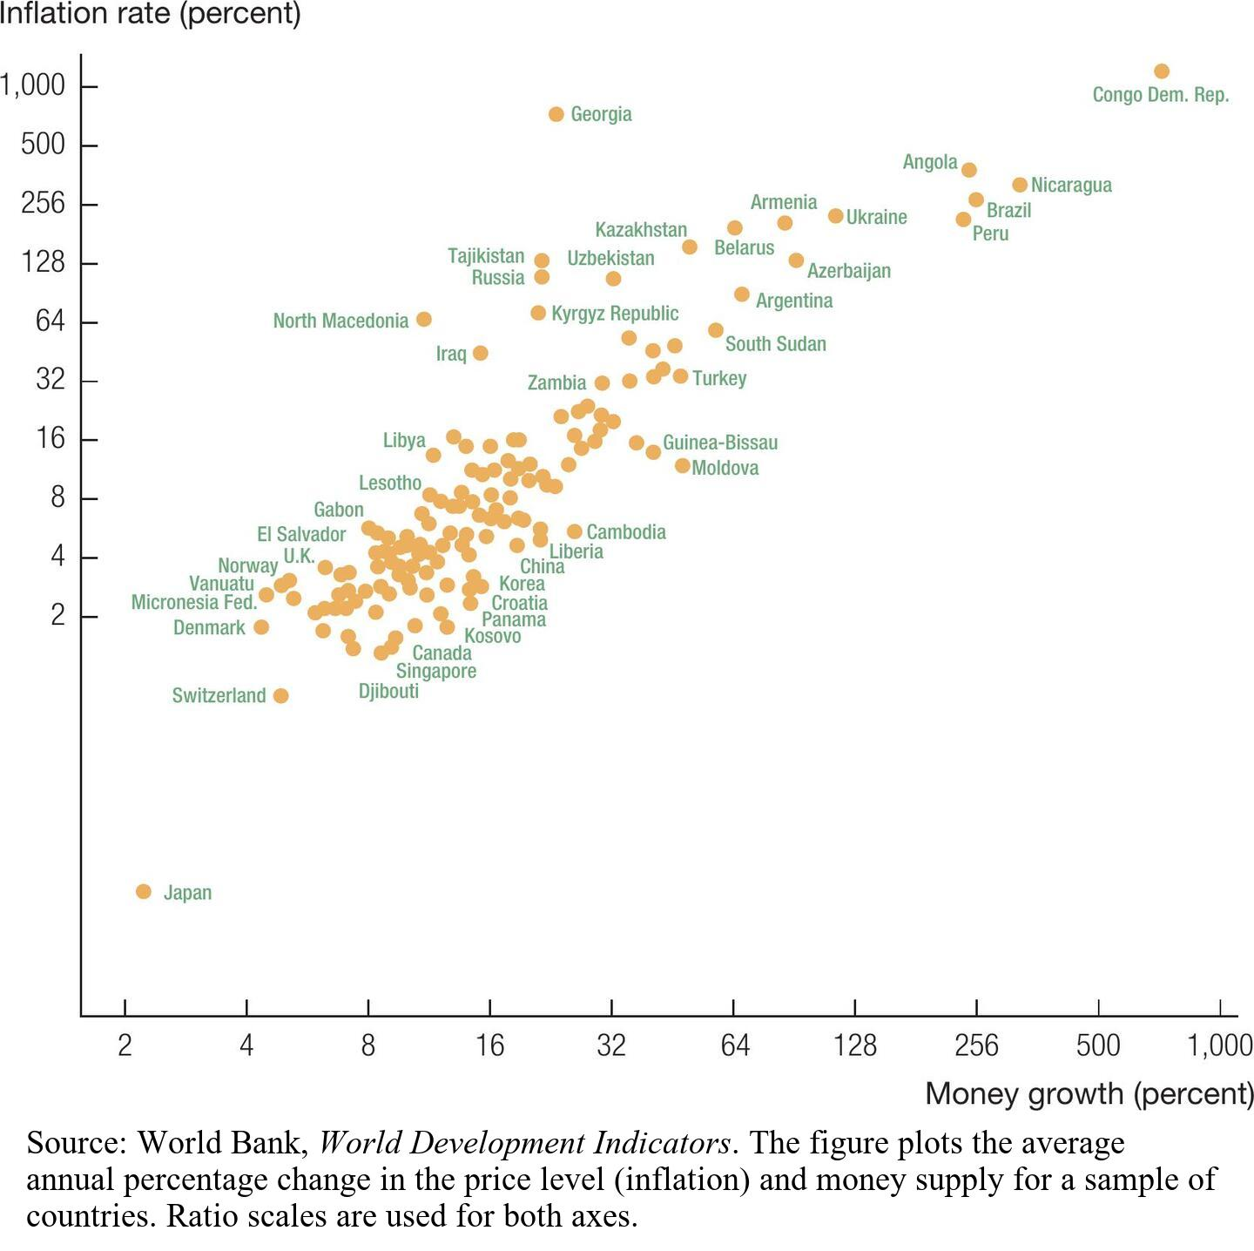
Money Growth and Inflation around the World, 1990–2021
Notes:
Image: Figure 8.4, Money Growth and Inflation around the World, 1990–2021
The quantity theory also holds across countries: countries with rapid money growth experience high inflation.
Figure 8.4 plots the average annual growth rate of money and the average annual rate of inflation after 1990 across a sample of countries.
The one-for-one prediction of the quantity theory holds up quite well.
In the lower left corner, many countries have low money growth and low inflation.
In Denmark and Switzerland, 𝑔 bar sub 𝑀 $≈$ 4% and 𝜋 $≈$ 1-2%.
In the low-to-middle range,
Libya and Lesotho
Some countries have high inflation and high money growth:
Turkey and Zambia
Others have very high inflation and money growth:
Nicaragua and the Democratic Republic of the Congo
Source: World Bank, World Development Indicators. The figure plots the average annual percentage change in the price level (inflation) and money supply for a sample of countries. Ratio scales are used for both axes.

Slide 22
Revisiting the Classical Dichotomy (1 of 2)
When all prices in the economy double, relative prices are unchanged.
When the relative prices of goods are unchanged, nothing real is affected.
Notes:
If a country were to replace its currency with a new one, and every green dollar was replaced with a blue dollar, relative prices would be unchanged.
Producers and consumers would not change their behavior.

Slide 23
Revisiting the Classical Dichotomy (2 of 2)
The neutrality of money says that changes in the money supply
have no real effects on the economy.
affect only prices.
Empirically
Holds in the long run
Does not hold in the short run
Nominal prices do not respond immediately to changes in the money supply.
Notes:
Now, suppose that the central bank doubles the money supply instead of changing the currency color.
All prices would double; relative prices will not have changed.
Again, there’s no reason for anyone to change any real behavior.
The quantity of goods produced and the allocation of those goods is unaffected.
The neutrality of money:
Changes in the money supply have no real effects on the economy and only affect prices.
In the long run, this makes sense.
In the short run, empirical evidence suggests that the neutrality of money does not.
Nominal prices do not respond immediately and precisely to changes in the money supply, so changes in the money supply can affect the real side of the economy over short horizons.
The classical dichotomy provides a good description of how the economy behaves in the long run but not in the short.

Slide 24
8.3 Real and Nominal Interest Rates
The real interest rate
is equal to the marginal product of capital.
is paid in goods.
The nominal interest rate
is the interest rate on a savings account.
is paid in dollars.
Notes:
In the long run, the real interest rate is equal to the marginal product of capital.
The real interest rate is the real return to purchasing a unit of capital, investing it, reaping the return to the investment, and then selling the capital.
It is the total amount (in consumption goods) you earn by this process.
The nominal interest rate is different; it is the stated rate of return for saving.
This is the interest you earn by taking money, putting it into a savings account, and earning a rate of return.
The real interest rate is paid in goods, while the nominal interest rate is paid in units of currency, like dollars.

Slide 25
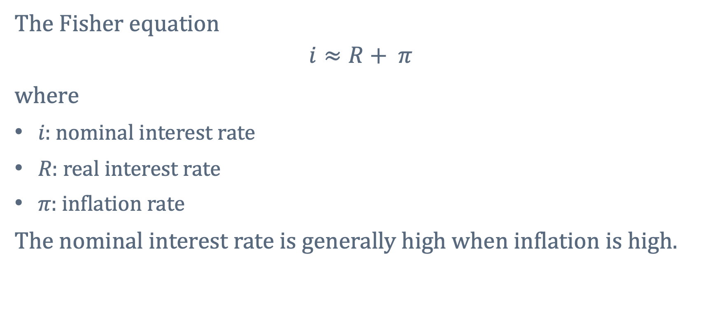
The Fisher Equation (1 of 2)
The Fisher equation
$$i≈R+ π$$
where
𝑖: nominal interest rate
𝑅: real interest rate
𝜋: inflation rate
The nominal interest rate is generally high when inflation is high.
Notes:
The price level allows us to convert nominal GDP to real GDP.
Interest rates are the return over the course of a year.
Therefore, the difference between the nominal interest rate and the real interest rate is the change in the price level, or the rate of inflation.
The relationship between nominal and real interest rates was developed by Irving Fisher.
If the real interest rate equals 5 percent, and the rate of inflation equals 3 percent, then the nominal interest rate will be about 8 percent.

Slide 26
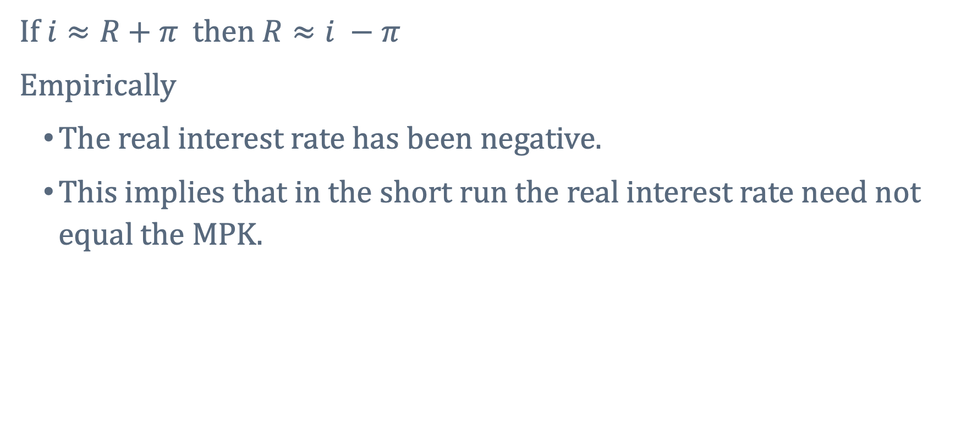
The Fisher Equation (2 of 2)
If $i≈R+π$ then $R≈i −π$
Empirically
The real interest rate has been negative.
This implies that in the short run the real interest rate need not equal the MPK.
Notes:
The real interest is computed by subtracting inflation from the nominal interest rate.
The real interest rate has been negative—although the MPK is surely not negative.
The real interest rate is not a statistic we can look up in the newspaper or the Economic Report of the President.

Slide 27
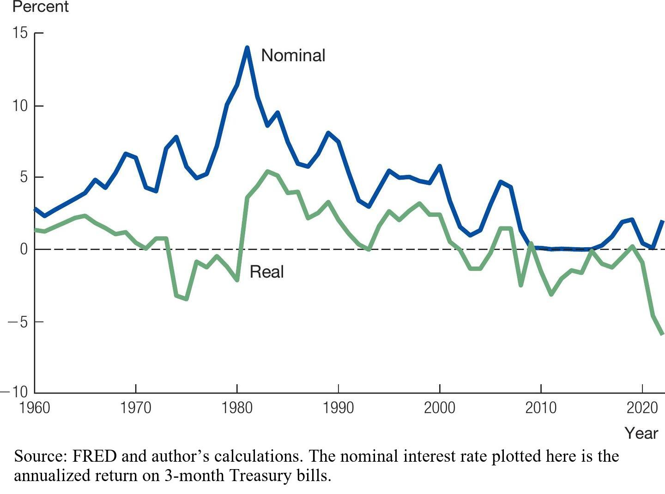
Real and Nominal Interest Rates in the United States
Notes:
Image: Figure 8.5, Real and Nominal Interest Rates in the United States
Figure 8.5 shows the nominal and real interest rates for the United States since 1960.
The nominal interest rate is the highest in 1981 at 14 percent.
Recall, inflation was its highest in 1980.
This relationship is described by the Fisher equation.
In 2009, the real interest rate actually became larger than the nominal interest rate.
This is due to deflation.
The real interest rate can also be negative.
This happened in the 1970s, 2003, and 2010–2018, when the nominal interest rate was very low.
In 2021-2022 the real interest rate became sharply negative when inflation spiked in the latter stages of the Covid-19 pandemic.
If the real interest rate were always equal to the marginal product of capital, then
these negative rates would be puzzling; the marginal product of capital is the extra amount of output that could be produced by installing an extra unit of capital, and
this amount is surely not negative.
Thus, in the short run, the real interest rate can depart from the marginal product of capital.
Source: FRED and author’s calculations. The nominal interest rate plotted here is the annualized return on 3-month Treasury bills.

Slide 28
8.4 Costs of Inflation
Individuals who are hurt during inflation:
An individual who has a pension that is not indexed to inflation
A bank that issues loans at fixed rates but that pays interest rates that move with the market
An individual with a variable rate mortgage

Slide 29
Costs of Inflation (1 of 3)
Large surprise inflations can lead to large distributions in wealth.
People with debts can pay back their loans with new cheaper dollars.
Creditors wind up losers.
Notes:
Low and stable inflation allows people and institutions to accurately predict inflation.
They can then incorporate the predicted level of inflation in contracts.
Surprise inflation can lead to a large redistribution of wealth.
Borrowers are winners, as the real amount of debt falls.
Inflation is particularly costly when it occurs in an unexpected fashion and in an environment that is not prepared for the change.

Slide 30
Costs of Inflation (2 of 3)
Taxes
Based on nominal incomes
Economic decisions
Based on real variables
Tax distortions are more severe when inflation is high.
Notes:
The United States in the 1970s experienced another cost of inflation as well, related to the interactions between inflation and the tax system.
In the United States and most countries, taxes are based on nominal income.
In contrast, correct economic decisions are made on the basis of real returns.
When inflation is high, your savings account may be earning a high nominal return that gets taxed, even though the real return is low.
After you pay the tax, the overall return is even lower, and this distortion is more severe when inflation is high.
Similarly, investments in new equipment or research and development (R&D) may
look good to businesses when inflation is low.
look bad when inflation is high if nominal returns are taxed.
So inflation will distort investment decisions.
Economists such as Martin Feldstein of Harvard University have argued that the interaction of inflation and the tax code had a large negative effect on investment during the 1970s.

Slide 31
Costs of Inflation (3 of 3)
Inflation also distorts relative prices.
Some prices are faster at adjusting to inflation than other prices.
Shoe leather costs of inflation
People want to hold less money when inflation is high.
Menu costs
The costs to firms of changing prices frequently
Notes:
Costs are not generated by the rate of inflation, but rather by the unexpectedness and uncertainty generated from surprise changes.
Inflation distorts relative prices: some prices adjust quickly to inflation, while others adjust slowly.
Relative prices signal to the economy how to allocate resources.
These distortions lead to resources being allocated in inefficient ways.
People want to hold less money when inflation is high, which means they must go to the bank more often.
This is called “shoe-leather costs” because of the implied cost of wearing out the soles of your shoes walking to the bank.
“Menu costs” are the costs to firms (not just restaurants) of changing prices.
When inflation is high, prices must be changed more frequently.
If inflation were perfectly anticipated, we could index transactions to inflation.
Unexpected inflation is the issue.

Slide 32
Case Study: The Wage-Price Spiral and President Nixon’s Price Controls
President Nixon’s Price Controls
Froze wages and prices for 90 days to break the spiral
High unemployment resulted from an expansionary policy that brought the return of inflation.
Unions negotiate higher w
Higher firm costs
Firms increase prices
Unions demand higher w
Inflation
Notes:
Facing reelection in 1972, Richard Nixon was confronted with an economy that featured rising inflation and relatively high unemployment.
After averaging less than 2 percent per year in the 1960s, inflation had reached 5 percent.
Unemployment, which had remained about 3.5 percent during much of the 1960s, had risen to 5 percent.
To maximize his chances for reelection, Nixon looked for a policy that would quickly address both problems.
A view at the time was that rising inflation resulted from a wage-price spiral:
strong unions pressed for higher wages,
strong corporations translated these rising costs into higher prices, and
strong unions demanded even higher wages,
leading to spiraling prices.
With this view in mind, President Nixon and his advisers announced a new economic policy in August 1971 that would freeze wages and prices at their current levels for a period of 90 days.
The goal was to break the wage-price spiral that was producing rising inflation.
If underlying monetary policy generates pressure for prices to rise, then such a solution cannot succeed.
Pent-up inflation will be released when price controls are lifted.
Price controls distort economic decisions resulting in shortages and long lines.

Slide 33
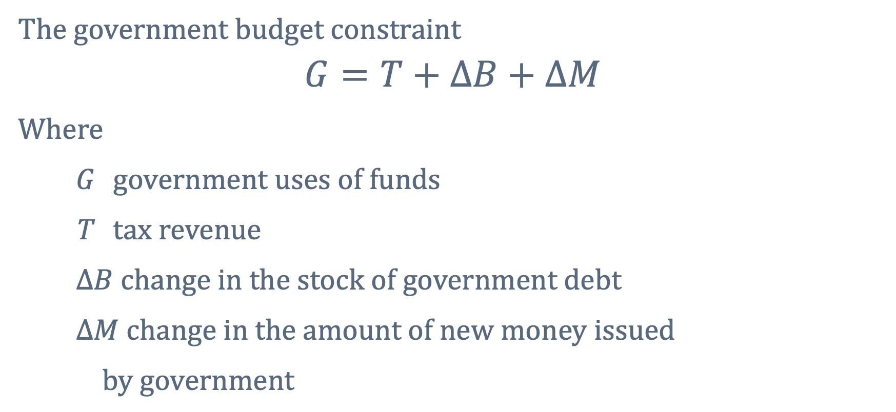
8.5 The Fiscal Causes of High Inflation
The government budget constraint
$$G=T+∆B+∆M$$
Where
G government uses of funds
T tax revenue
$∆B change in the stock of government debt$
$∆M change in the amount of new money issued$
$by government$
Notes:
Inflation can be high if the central bank increases the money supply.
Since inflation can be costly, why would the central bank increase inflation?
Printing money is one way for the government to pay its bills.
The government’s uses of funds must equal its sources of funds.

Slide 34
The Inflation Tax (1 of 2)
Seigniorage and the inflation tax
Names for the revenue that the government obtains from printing more money (ΔM)
The inflation tax
Shows up as a rise in the price level.
Is paid by people holding currency.
Notes:
The revenue the government obtains by issuing new money (delta M) is called seigniorage, or the inflation tax.
By printing money, the government is taking resources from the rest of the economy, but from whom exactly?
Suppose each person in the economy holds $200 in currency.
Now suppose the government decides to double the money supply.
It prints an extra $200 for each person but then spends that currency itself.
From the quantity theory of money, we know that the long-run effect of this monetary expansion is to double the price level.
Therefore, the $200 of currency held by the private sector is now worth only half as much in real terms.
People must now pay prices that are twice as high.
The inflation tax, which shows up as a rise in the price level, is thus paid by people holding currency.

Slide 35
The Inflation Tax (2 of 2)
If a government runs large budget deficits, as debt rises,
lenders may worry government will have trouble paying back loans.
they may stop lending to the government altogether.
Debt solution: Raising taxes?
May not be politically feasible.
The government may resort to printing currency to finance its budget.
Lenders to the government will be paid back in currency that is worth less than the dollars lent.
Notes:
Governments finance spending through conventional taxes and borrowing.
In certain times and places, however, this may be difficult.
Imagine a government that has run a large and growing budget deficit over the last decade:
that is, G is larger than T, so the government is spending more than it receives in tax revenue.
Suppose also that the government has financed these budget deficits by borrowing in units of the local currency, say dollars.
As the debt rises, lenders to the government may start to worry that it will have trouble paying back its debts, and they may charge higher and higher interest rates.
Eventually, they may stop lending to the government altogether.
If the budget deficit is 5 percent of GDP, the government may also find it difficult for political reasons to raise taxes by this large amount.
In such a situation, the government may well resort to printing currency to pay for its spending and to pay back its loans.
That is, when regular taxes and borrowing dry up as sources of revenue, the government may be forced to fall back on the inflation tax.
And this validates the concern that debt holders had about the government’s ability to pay them back:
They are repaid in units of currency that are worth much less than the dollars they lent.

Slide 36
Central Bank Independence
Monetary policy
Conducted by Federal Reserve
Fiscal policy
President and Congress
Central bank independence
An attempt to prevent fiscal considerations from leading to excessive inflation
Notes:
The temptation to print money to pay for its spending is there for all governments.
To avoid this temptation, many countries establish a kind of separation between the central bank and the branches of government responsible for spending and taxation.
In the United States, for example, the federal government cannot order the Federal Reserve to issue more currency so that the government can pay its bills.
Instead, decisions about monetary policy are conducted by the Federal Reserve, and decisions about government spending and taxation are conducted by the president and Congress.
In much of Western Europe, these decisions are even more sharply separated:
Each country that uses the euro has its own government, which is responsible for spending and taxation.
Monetary policy is conducted by a multinational European Central Bank.
In general, then, central bank independence is an attempt to prevent fiscal considerations from leading to excessive inflation.
At some level, though, the central bank is part of the government, and the head of the central bank is typically a political appointee.
For example, in the United States, the president appoints the chair of the Federal Reserve.
In principle, the president could request the resignation of a Federal Reserve chair and install someone more sympathetic to issuing currency to pay the government's bills.
The independence of the central bank, then, is an ideal that invariably comes under threat when there are problems with the government's budget constraint.

Slide 37
Case Study: Episodes of High Inflation (1 of 2)
Episodes of high inflation tend to recur.
Hyperinflation can stop just as quickly as it starts.
Countries experiencing hyperinflation typically raise about 5 percent of GDP from the inflation tax.
Argentina raised 10 percent of GDP this way.
Notes:
How do episodes of high inflation or hyperinflation end?
The answer from the quantity theory is that they end when the rate of money growth falls sharply.
The more fundamental analysis of the government’s budget constraint, however, reveals that this can occur only when the government makes difficult choices to get its finances in order:
Typically through a combination of lower spending, higher taxes, and new loans.

Slide 38
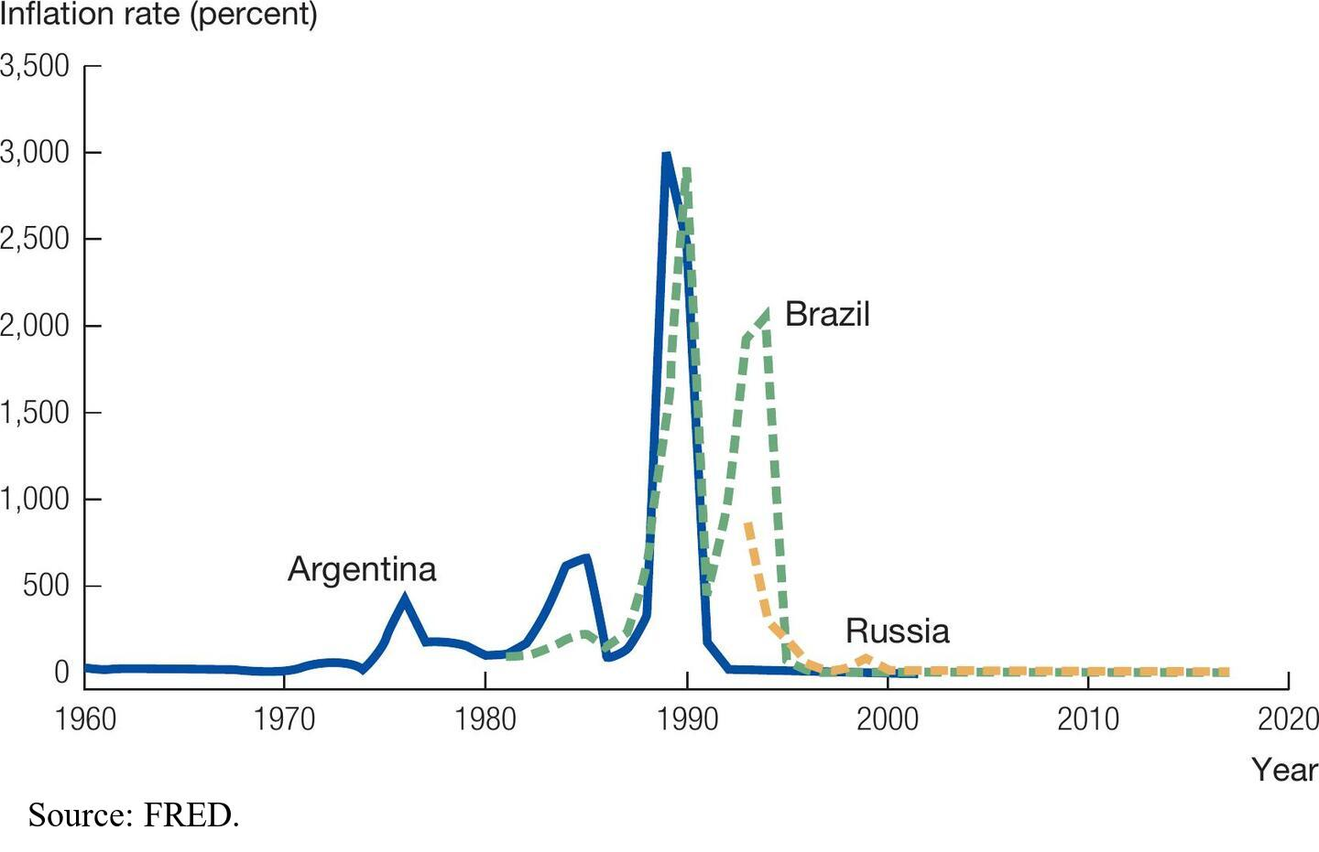
Hyperinflations in Argentina, Brazil, and Russia
Notes:
Image: Figure 8.6, Hyperinflations in Argentina, Brazil, and Russia
Figure 8.6 shows rates of inflation for Argentina, Brazil, and Russia in recent decades.
In Argentina and Brazil, we see two interesting patterns.
First, episodes of high inflation tend to recur.
Second, hyperinflations can stop just as quickly as they start.
Even though inflation rates in the early 1990s were more than 2,000 percent per year in Argentina and Brazil,
they dropped to below 5 percent just a few years after the peaks in both countries.
Source: IMF, International Financial Statistics.

Slide 39
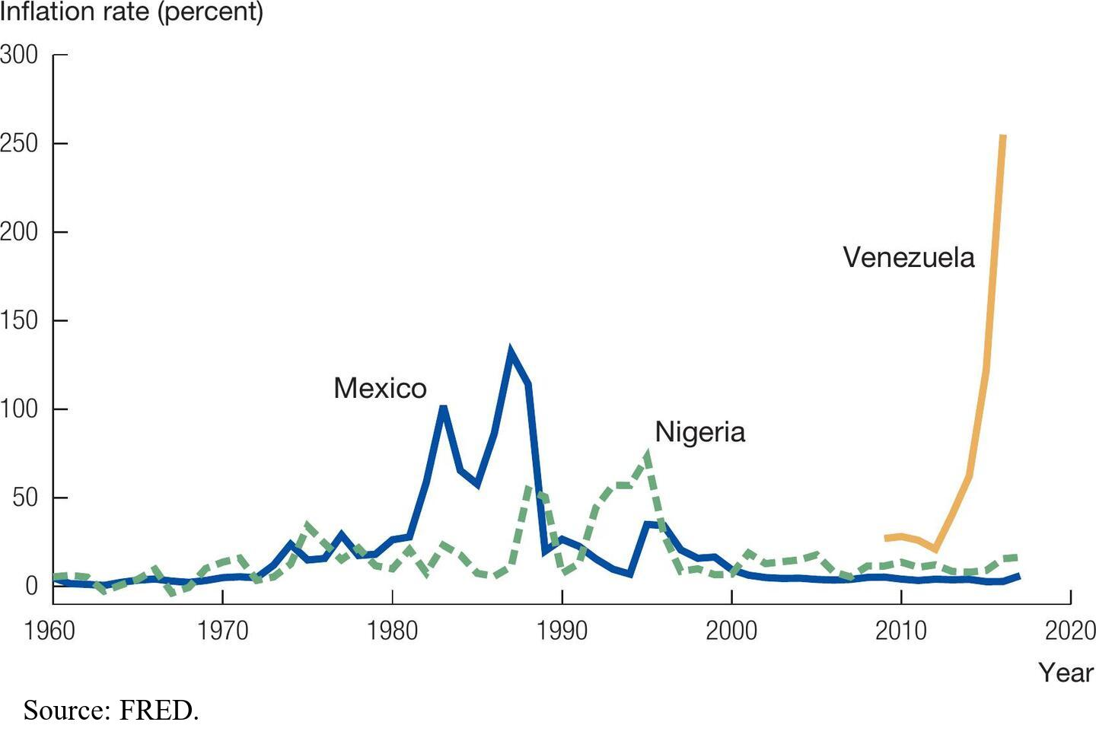
High Inflation in Mexico, Nigeria, and Venezuela
Notes:
Image: Figure 8.7, High Inflation in Mexico, Nigeria, and Venezuela.
Mexico and Nigeria experienced high inflation, but not what we would call hyperinflation. Venezuela is now suffering from hyperinflation and economic disaster.
Source: IMF, International Financial Statistics.

Slide 40
Case Study: Episodes of High Inflation (2 of 2)
Hyperinflation
Ends when the rate of money growth falls rapidly.
The government gets its finances in order through lower spending, higher taxes, and new loans.
The coordination problem
People build their expectations into the prices they set.
Notes:
Another difficulty in ending high inflation is what’s known as a coordination problem.
Imagine you are a business owner and you have to choose how to set your prices in the coming week.
If the rate of inflation has been high and perhaps rising for the last year,
You will build a high and rising rate of inflation into your prices.
Other firms will do this as well, as will workers as they bargain over wages.
This coordination injects a certain inertia into the inflation process.
At some level, all the price setters in the economy have to be convinced that the high inflation of recent years is going to end, and this coordination problem can be hard to solve.
For both these reasons, because fiscal reform involves difficult choices and because of the coordination problem, halting hyperinflations is not easy.
These issues also help us understand why hyperinflations can recur.

Slide 41
8.6 The Great Inflation of the 1970s
During the Great Inflation,
the rate peaked below 15 percent.
the inflation tax was a small fraction of government spending.
Inflation rose in the 1970s because
OPEC coordinated increases in oil prices.
the Fed increased the money supply too rapidly.
policymakers were concerned about the productivity slowdown.
Notes:
The fiscal justification for printing more money:
When the government is forced to turn to the printing press in order to satisfy its budget constraint
Works well for hyperinflations
But what about the Great Inflation of the 1970s in the United States?
Inflation was high in the 1970s by historical standards, but the rate peaked at below 15 percent.
Even at this peak, revenue from the inflation tax made up only a tiny fraction of government spending, so the fiscal explanation of inflation does not apply to the Great Inflation in the United States.
The revenue earned was too small to be a key factor.

Slide 42
Clicker Question 1
A government is more likely to utilize the inflation tax if
it is running a budget deficit.
lenders worry that the government will not pay back its debts.
politicians will not raise taxes, because they cannot be reelected if they do.
All of the above are correct.

Slide 43
Clicker Question 1: Answer
A government is more likely to utilize the inflation tax if
it is running a budget deficit.
lenders worry that the government will not pay back its debts.
politicians will not raise taxes, because they cannot be reelected if they do.
All of the above are correct.
Notes:
Clicker question:
Answer: D, All of the above are correct.
The inflation tax is likely to be used as a last resort. If deficits are high and additional borrowing and taxing are impossible, the inflation tax will be used to raise revenue. See pages 244–246.

Slide 44
Clicker Question 2
Which of the following people benefits from a surprise increase in inflation?
a person receiving a fixed pension
a person with a variable rate mortgage
a person who borrowed large amounts of money on a fixed payment schedule
a lender of large amounts of money who is repaid on a fixed schedule

Slide 45
Clicker Question 2: Answer
Which of the following people benefits from a surprise increase in inflation?
a person receiving a fixed pension
a person with a variable rate mortgage
a person who borrowed large amounts of money on a fixed payment schedule
a lender of large amounts of money who is repaid on a fixed schedule
Notes:
Clicker question:
Answer: C, a person who borrowed large amounts of money on a fixed payment schedule
Borrowers with fixed interest rate loans benefit because they can repay their debts using the newer and cheaper dollars. See pages 241–242.

Slide 46
Clicker Question 3
Which of the following will have a real effect on the United States economy?
The Federal Reserve replaces dollar bills with “Monopoly” dollar bills.
The Federal Reserve replaces every dollar in the economy with two dollars.
The Federal Reserve adds new security features on the dollar bill.
None of these choices are correct.

Slide 47
Clicker Question 3: Answer
Which of the following will have a real effect on the United States economy?
The Federal Reserve replaces dollar bills with “Monopoly” dollar bills.
The Federal Reserve replaces every dollar in the economy with two dollars.
The Federal Reserve adds new security features on the dollar bill.
None of these choices are correct.
Notes:
Clicker question:
Answer: D, None of these choices are correct.
Changes in the money supply will have no real effect on the economy unless the relative price of goods is changed. The changes in answer options A-C do not alter relative prices. See pages 238–239.

Slide 48
Clicker Question 4
The quantity theory of money says that a doubling of the growth rate in the money supply will, in the long run, lead to
a doubling of real GDP growth.
a doubling of inflation.
a decrease of inflation.
a doubling of the price level.

Slide 49
Clicker Question 4: Answer
The quantity theory of money says that a doubling of the growth rate in the money supply will, in the long run, lead to
a doubling of real GDP growth.
a doubling of inflation.
a decrease of inflation.
a doubling of the price level.
Notes:
Clicker question:
Answer: B, a doubling of inflation.
In the long run, changes in the growth rate of money will lead to a one-for-one change in the inflation rate. See page 236.

Slide 50
Clicker Question 5
The Great Inflation of the 1970s was partially caused by
the inflation tax used to finance the Vietnam War.
increases in oil prices.
a money supply that was growing too quickly.
both B and C.

Slide 51
Clicker Question 5: Answer
The Great Inflation of the 1970s was partially caused by
the inflation tax used to finance the Vietnam War.
increases in oil prices.
a money supply that was growing too quickly.
both B and C.
Notes:
Clicker question:
Answer: D, both B and C.
Increases in oil prices spurred inflation while the Federal Reserve made mistakes in running a too-loose monetary policy. See page 249.

Slide 52
Clicker Question 6
A country experiencing a hyperinflation is likely to have
a low nominal interest rate.
another hyperinflation after the current problem is solved.
a government surplus.
a low inflation tax.

Slide 53
Clicker Question 6: Answer
A country experiencing a hyperinflation is likely to have
a low nominal interest rate.
another hyperinflation after the current problem is solved.
a government surplus.
a low inflation tax.
Notes:
Clicker question:
Answer: B, another hyperinflation after the current problem is solved.
Hyperinflations are usually a recurring phenomenon because it is difficult to end a hyperinflation. Fiscal stability is not easily restored and coordination problems are not easily overcome. See pages 247–248.

Slide 54
Clicker Question 7
Under the classical dichotomy, which of the following does not determine real GDP in the long run?
the investment rate
the aggregate price level
TFP
new ideas

Slide 55
Clicker Question 7: Answer
Under the classical dichotomy, which of the following does not determine real GDP in the long run?
the investment rate
the aggregate price level
TFP
new ideas
Notes:
Clicker question:
Answer: B, the aggregate price level
In the long run, real GDP is determined only by real considerations and not by variables, such as money or the aggregate price level. See pages 234.

Slide 56
Clicker Question 8
In the long run, the key determinant of the price level is
the money supply.
real GDP.
the velocity of money.
the growth rate of money.

Slide 57
Clicker Question 8: Answer
In the long run, the key determinant of the price level is
the money supply.
real GDP.
the velocity of money.
the growth rate of money.
Notes:
Clicker question:
Answer: A, the money supply.
The price level is determined by the money supply, while the inflation rate is pinned down by the growth rate in the money supply. See pages 235–236.

Slide 58
Clicker Question 9
According to the quantity theory of money, increases in the money supply and in real GDP will cause inflation.
true
false

Slide 59
Clicker Question 9: Answer
According to the quantity theory of money, increases in the money supply and in real GDP will cause inflation.
true
false
Notes:
Clicker question:
Answer: B, false
After solving the quantity theory of money model, we realize that increases in the money supply and decreases in real GDP will cause inflation. See pages 235–236.

Slide 60
Clicker Question 10
The monetary base contains elements that are more liquid than M2.
true
false

Slide 61
Clicker Question 10: Answer
The monetary base contains elements that are more liquid than M2.
true
false
Notes:
Clicker question:
Answer: A, true
The broader measures of the money supply (M2 is broader than the monetary base) contain accounts that are less liquid. Thus, the monetary base is more liquid. See page 232.

Slide 62
Clicker Question 11
Empirically, money is neutral in the short run as well as the long run.
true
false

Slide 63
Clicker Question 11: Answer
Empirically, money is neutral in the short run as well as the long run.
true
false
Notes:
Clicker question:
Answer: B, false
The neutrality of money fails in the short run, because nominal prices do not respond immediately to changes in the money supply. See pages 238–239.

Slide 64
Clicker Question 12
If real GDP is growing at a rate of 2 percent, the central bank should grow the money supply at a rate of 2 percent to keep prices unchanged.
true
false

Slide 65
Clicker Question 12: Answer
If real GDP is growing at a rate of 2 percent, the central bank should grow the money supply at a rate of 2 percent to keep prices unchanged.
true
false
Notes:
Clicker question:
Answer: A, true
Prices are stable when the inflation rate is 0 percent. This occurs when the growth rate in the money supply is equal to the growth rate of real output. See page 236.

Slide 66
Clicker Question 13
If the real interest rate is 3 percent and the nominal interest rate is 1 percent, then the economy is experiencing deflation according to the Fisher equation.
true
false

Slide 67
Clicker Question 13: Answer
If the real interest rate is 3 percent and the nominal interest rate is 1 percent, then the economy is experiencing deflation according to the Fisher equation.
true
false
Notes:
Clicker question:
Answer: A, true
The inflation rate is equal to the nominal interest rate minus the real interest rate, which is negative in this example. See page 239.

Slide 68
Clicker Question 14
The inflation tax will affect an individual who holds all his assets in artwork.
true
false

Slide 69
Clicker Question 14: Answer
The inflation tax will affect an individual who holds all his assets in artwork.
true
false
Notes:
Clicker question:
Answer: B, false
Holders of currency pay only the inflation tax. Because all prices in the economy are influenced by the inflation tax, the value of the artwork changes proportionately with all other prices. See pages 244–245.

Slide 70
Clicker Question 15
Price differences over time are actually larger than the raw difference in prices between any two years, because inflation has eroded the value of the dollar over time.
true
false

Slide 71
Clicker Question 15: Answer
Price differences over time are actually larger than the raw difference in prices between any two years, because inflation has eroded the value of the dollar over time.
true
false
Notes:
Clicker question:
Answer: B, false
Because inflation has eroded the value of the dollar, price differences between a good purchased in 1950 and today are actually smaller than they seem after adjusting. See pages 230–231.

Slide 72
Clicker Question 16
If the price level in year 1 was equal to 100 and the price level in year 2 was equal to 1,000, in year 2 the country is experiencing
inflation.
hyperinflation.
deflation.
stable prices.

Slide 73
Clicker Question 16: Answer
If the price level in year 1 was equal to 100 and the price level in year 2 was equal to 1,000, in year 2 the country is experiencing
inflation.
hyperinflation.
deflation.
stable prices.
Notes:
Clicker question:
Answer: B, hyperinflation.
The inflation rate is measured with the annual percentage change in the price level(P_{t+1} –P_{t}) / P_{t}.In this case, the inflation rate is 900 percent. An episode of extremely high inflation is known as hyperinflation.

Slide 74
Clicker Question 17
The wholesale price of one pound of coffee was 8.25 cents in 1900 and $1.50 in 2015. If the CPI was 3.43 for 1900 and 100 for 2015, coffee was
less expensive in 2015 compared to 1900.
more expensive in 2015 compared to 1900.
less expensive in 1900 compared to 2015.
as expensive in 2015 as it was in 1900.

Slide 75
Clicker Question 17: Answer
The wholesale price of one pound of coffee was 8.25 cents in 1900 and $1.50 in 2015. If the CPI was 3.43 for 1900 and 100 for 2015, coffee was
less expensive in 2015 compared to 1900.
more expensive in 2015 compared to 1900.
less expensive in 1900 compared to 2015.
as expensive in 2015 as it was in 1900.
Notes:
Clicker question:
Answer: A, less expensive in 2015 compared to 1900.
We can find the equivalent 2015 value of the 1900 price using the equation: value in 1900 x (CPI 2015/CPI 1900).Thus, the equivalent 2015 value of $0.0825 is $2.41, which makes coffee less expensive in 2015. See pages 230–231.

Slide 76
Clicker Question 18
Suppose that nominal GDP is $5,000 and the velocity of money is equal to 5. According to the quantity theory of money, what is the amount of money in circulation?
$100
$500
$1,000
$5,000

Slide 77
Clicker Question 18: Answer
Suppose that nominal GDP is $5,000 and the velocity of money is equal to 5. According to the quantity theory of money, what is the amount of money in circulation?
$100
$500
$1,000
$5,000
Notes:
Clicker question:
Answer: C, $1,000
Applying equation 8.1, where 𝑀_𝑡 is the unknown variable, 𝑉_𝑡 = 5 and 𝑃_𝑡 𝑌_𝑡 = $5,000. Solving for 𝑀_𝑡 yields 𝑀_𝑡=$1,000.

Slide 78
Clicker Question 19
Suppose the government decides to spend $500 million on infrastructure improvement projects. Part of the financing will be from additional borrowing in the amount of $200 million. An increase in taxes will bring an extra $200 million. If the government decides to print new money to finance the rest, how much will the seignorage be?
$500 million
$200 million
$50 million
$100 million

Slide 79
Clicker Question 19: Answer
Suppose the government decides to spend $500 million on infrastructure improvement projects. Part of the financing will be from additional borrowing in the amount of $200 million. An increase in taxes will bring an extra $200 million. If the government decides to print new money to finance the rest, how much will the seignorage be?
$500 million
$200 million
$50 million
$100 million
Notes:
Clicker question:
Answer: D, $100 million
Apply equation 8.7, where 𝐺 = $500 𝑚𝑖𝑙𝑙𝑖𝑜𝑛, 𝑇 = $200 𝑚𝑖𝑙𝑙𝑖𝑜𝑛, ∆𝐵 = $200 𝑚𝑖𝑙𝑙𝑖𝑜𝑛, and ∆𝑀 is the unknown variable. Solving for ∆𝑀 yields ∆𝑀 = $100 𝑚𝑖𝑙𝑙𝑖𝑜𝑛.

Slide 80
Clicker Question 20
Many countries do not have a central bank that is separated from its government. What are some of the problems with not having an independent central bank?
inflation
corruption
both inflation and corruption
none of the above

Slide 81
Clicker Question 20: Answer
Many countries do not have a central bank that is separated from its government. What are some of the problems with not having an independent central bank?
inflation
corruption
both inflation and corruption
none of the above
Notes:
Clicker Question:
Answer: C, both inflation and corruption
Central bank independence is an attempt to prevent both inflation and corruption. See page 246.

Slide 82
Clicker Question 21
Many countries do not have a central bank that is separated from its government. What are some of the benefits of having an independent central bank?
keeping business cycles separate from political cycles
better control over inflation
reduction of deficit spending
all of the above

Slide 83
Clicker Question 21: Answer
Many countries do not have a central bank that is separated from its government. What are some of the benefits of having an independent central bank?
keeping business cycles separate from political cycles
better control over inflation
reduction of deficit spending
all of the above
Notes:
Clicker Question:
Answer: D, all of the above
Advantages
Having an apolitical central bank obviously has many advantages. Some of them have been listed below.
Political cycle vs. business cycle: It is not necessary that periods of boom and bust will coincide with the political cycles. Also, if they do, politicians may have a conflict of interest. For instance, if there is too much inflation during an election year, politicians might simply skip the necessary but unpopular decision of implementing rate hikes. The economy and elections are not naturally correlated. Hence, it is imperative that the decisions regarding the economy be taken independently.
Inflation: Controlling inflation is the primary objective of any central bank. In order to do so, they need to control the money spent by the government.
Deficit spending: Governments all over the world are fond of undertaking populist projects even though such projects are not supported by economic fundamentals.
See page 246.

Slide 84
Credits
This concludes the Lecture PowerPoint presentation for Chapter 8, Inflation, of Macroeconomics, 6e by Charles I. Jones
For more resources, please visit http://digital.wwnorton.com/macro6

